Slide 1
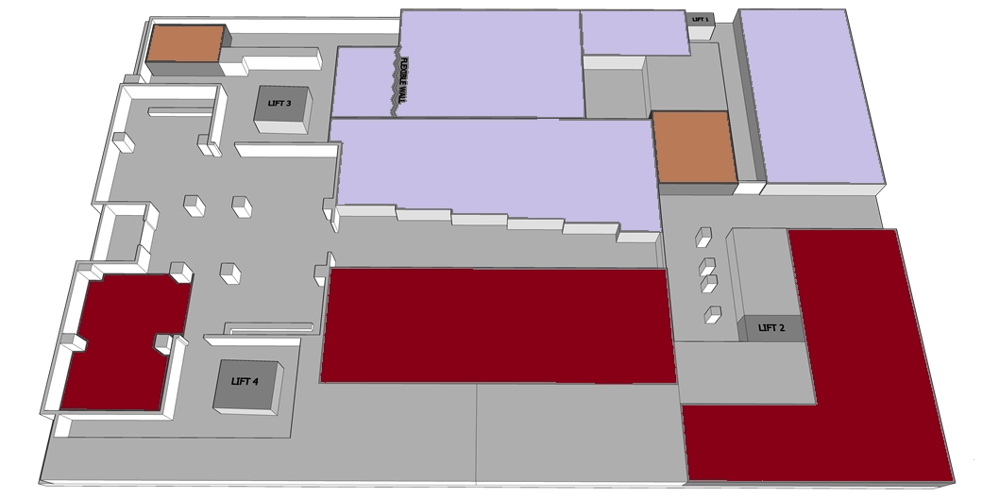
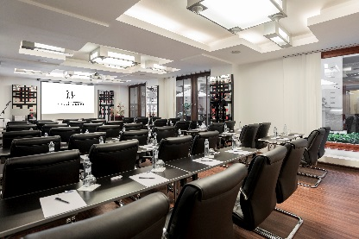
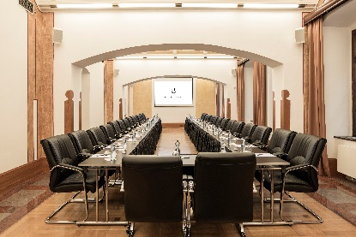
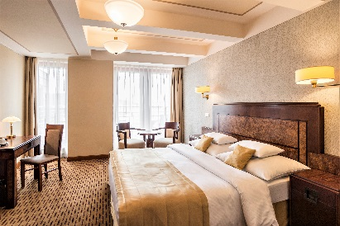
FLOOR PLAN OVERVIEW
Meeting Room Majestic III.
22 m²
Meeting Room Majestic II.
83 m²
BOARD ROOM
15 m²
Meeting Room Majestic I.
80 m²
Lobby bar
WC
LIFT 5
WC
Štěpánská street
Školská street
Entrance
to The hotel
Reception
Restaurant Victoria
83 m²
Meeting Room Majestic IV.
133 m²
Restaurant Asmera
56 m²
Majestic Plaza
Štěpánska 33, Praha 1, 110 00, CZ
Tel.:+420 221 486 100 Fax.: +420 221 486 486
E-mail: reservation@hotel-majestic.cz
Web: www.hotel-majestic.cz

Slide 2
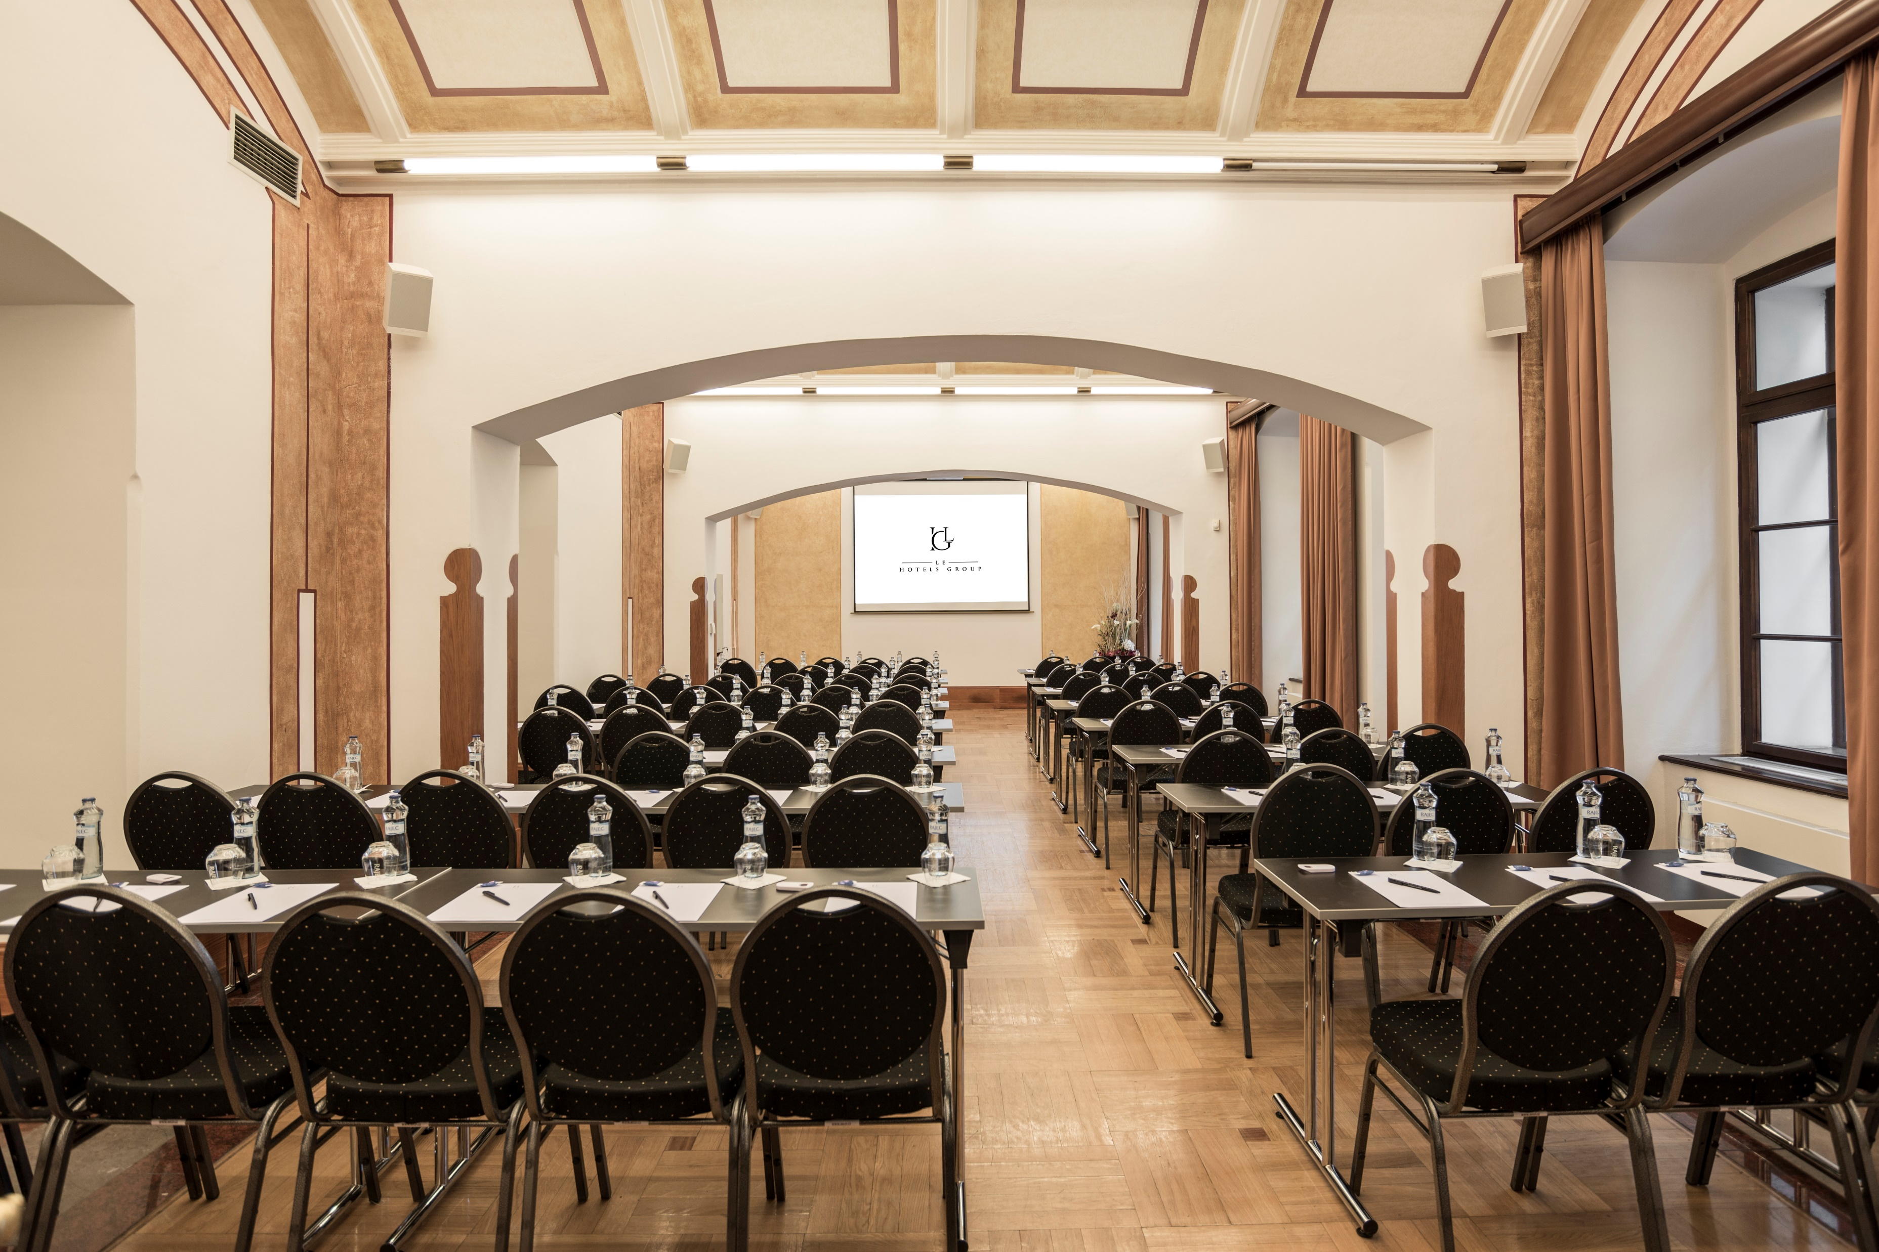
MEETING ROOM MAJESTIC I.
Location: Ground Floor
Dimensions on metric: 80 m² (12,4 x 6 × 2,7 metres)
Cocktail: 80 pax
Theatre: 70 pax
Classroom 2 pax table: 44 pax
U-shape: 30 pax
Cabaret 6 pax (150 cm Table): 42 pax
Banquet 10 pax (180 cm Table): 40 pax
Block B2B: 30 pax
Exhibition table top: 14 tables

Slide 3
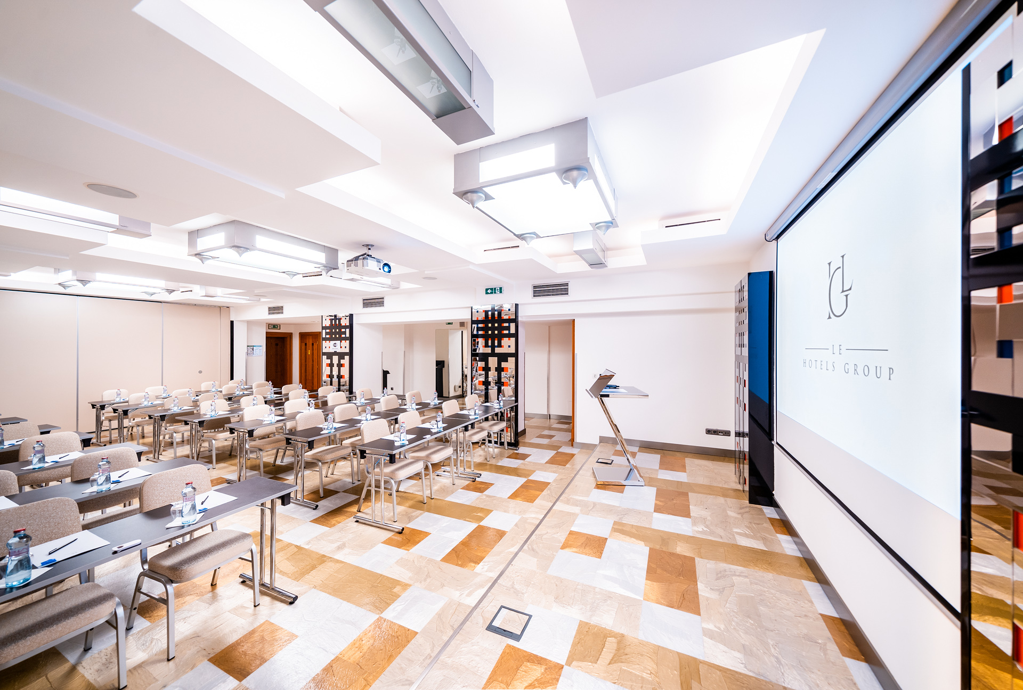
MEETING ROOM MAJESTIC II.
Location: Ground Floor
Dimensions on metric: 83 m² (11 x 5 × 2,7 metres)
Cocktail: 80 pax
Theatre: 70 pax
Classroom 2 pax table: 42 pax
U-shape: 26 pax
Cabaret 6 pax (150 cm Table): 42 pax
Banquet 10 pax (180 cm Table): 40 pax
Block B2B: 30 pax
Exhibition table top: 14 tables

Slide 4
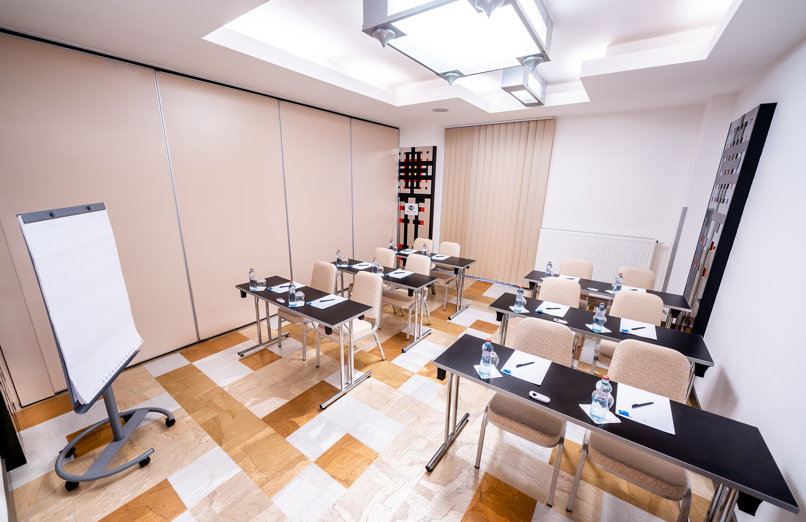
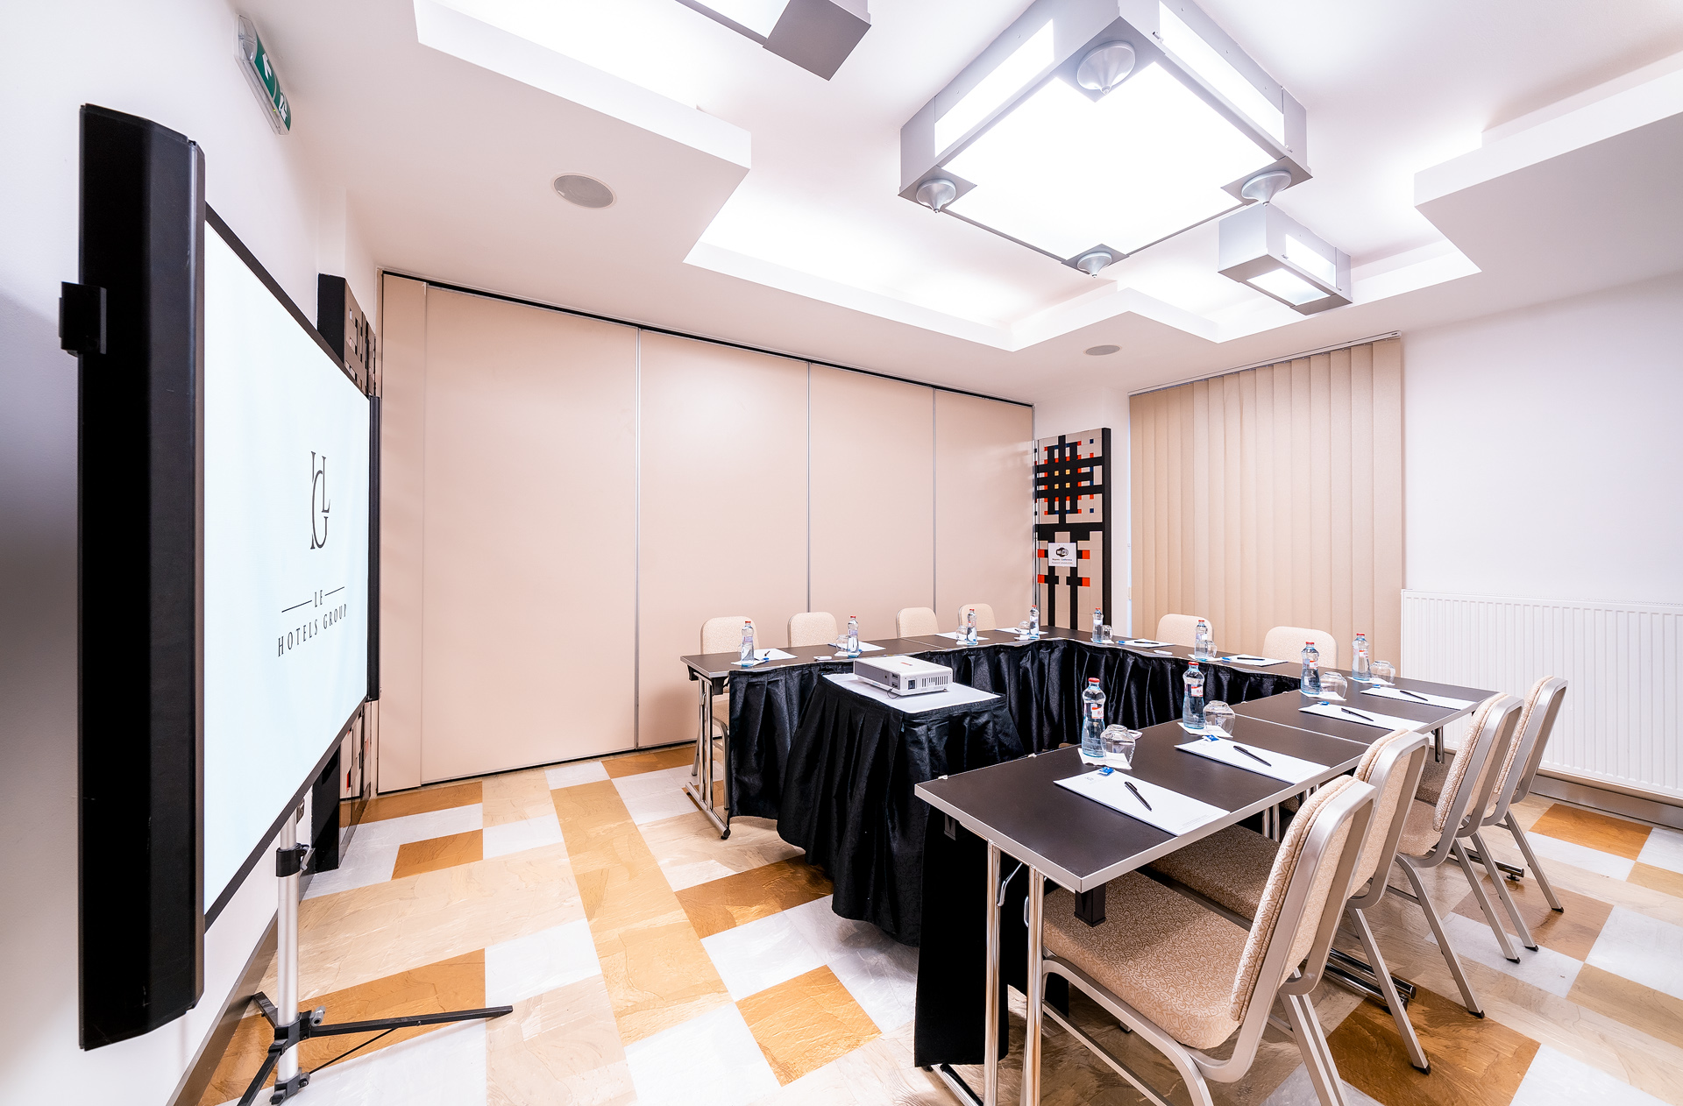
MEETING ROOM MAJESTIC III.
Location: Ground Floor
Dimensions on metric: 22 m² (4,1 x 5 × 2,7 metres)
Cocktail: 20 pax
Theatre: 20 pax
Classroom 2 pax table: 12 pax
U-shape: 10 pax
Cabaret 6 pax (150 cm Table): 12 pax
Banquet 10 pax (180 cm Table): 10 pax
Block B2B: 4 pax
Exhibition table top: 4 tables

Slide 5
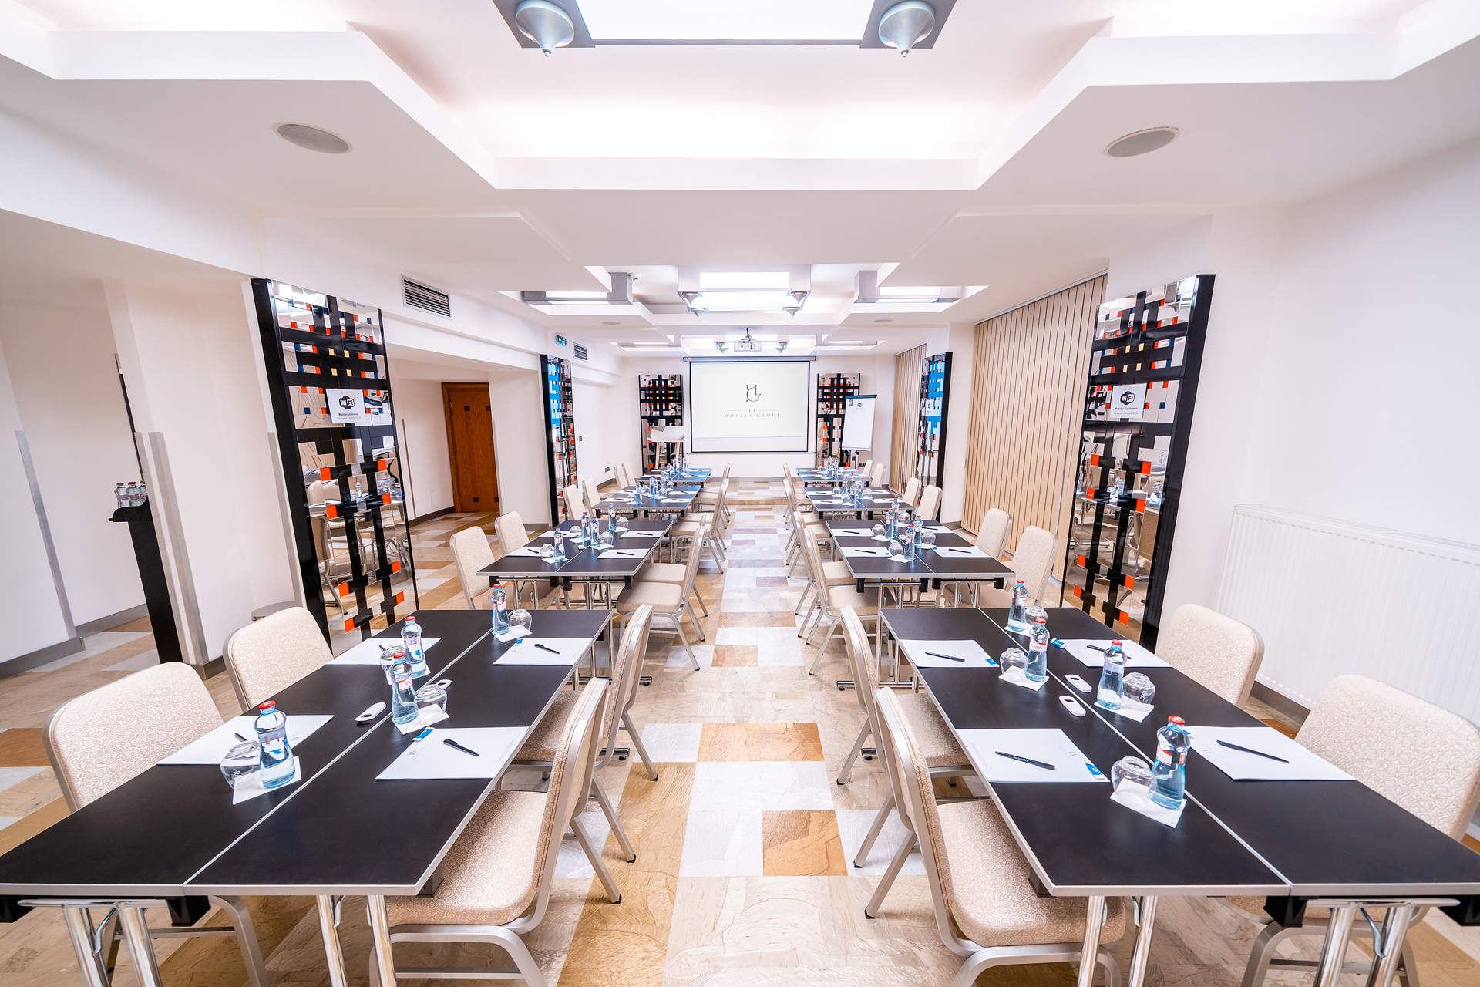
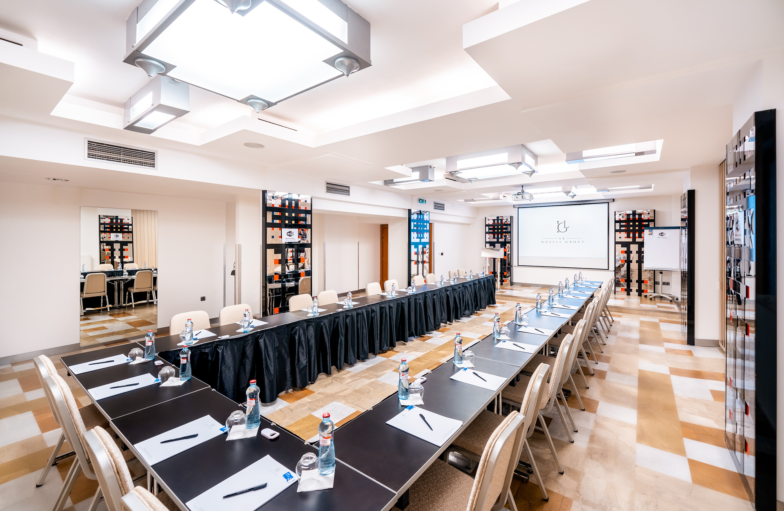
MEETING ROOM MAJESTIC II. + III.
Location: Ground Floor
Dimensions on metric: 105 m² (15,4 x 5,5 × 2,7 metres)
Cocktail: 100 pax
Theatre: 100 pax
Classroom 2 pax table: 54 pax
U-shape: 34 pax
Cabaret 6 pax (150 cm Table): 42 pax
Banquet 10 pax (180 cm Table): 50 pax
Block B2B: 34 pax
Exhibition table top: 18 tables

Slide 6
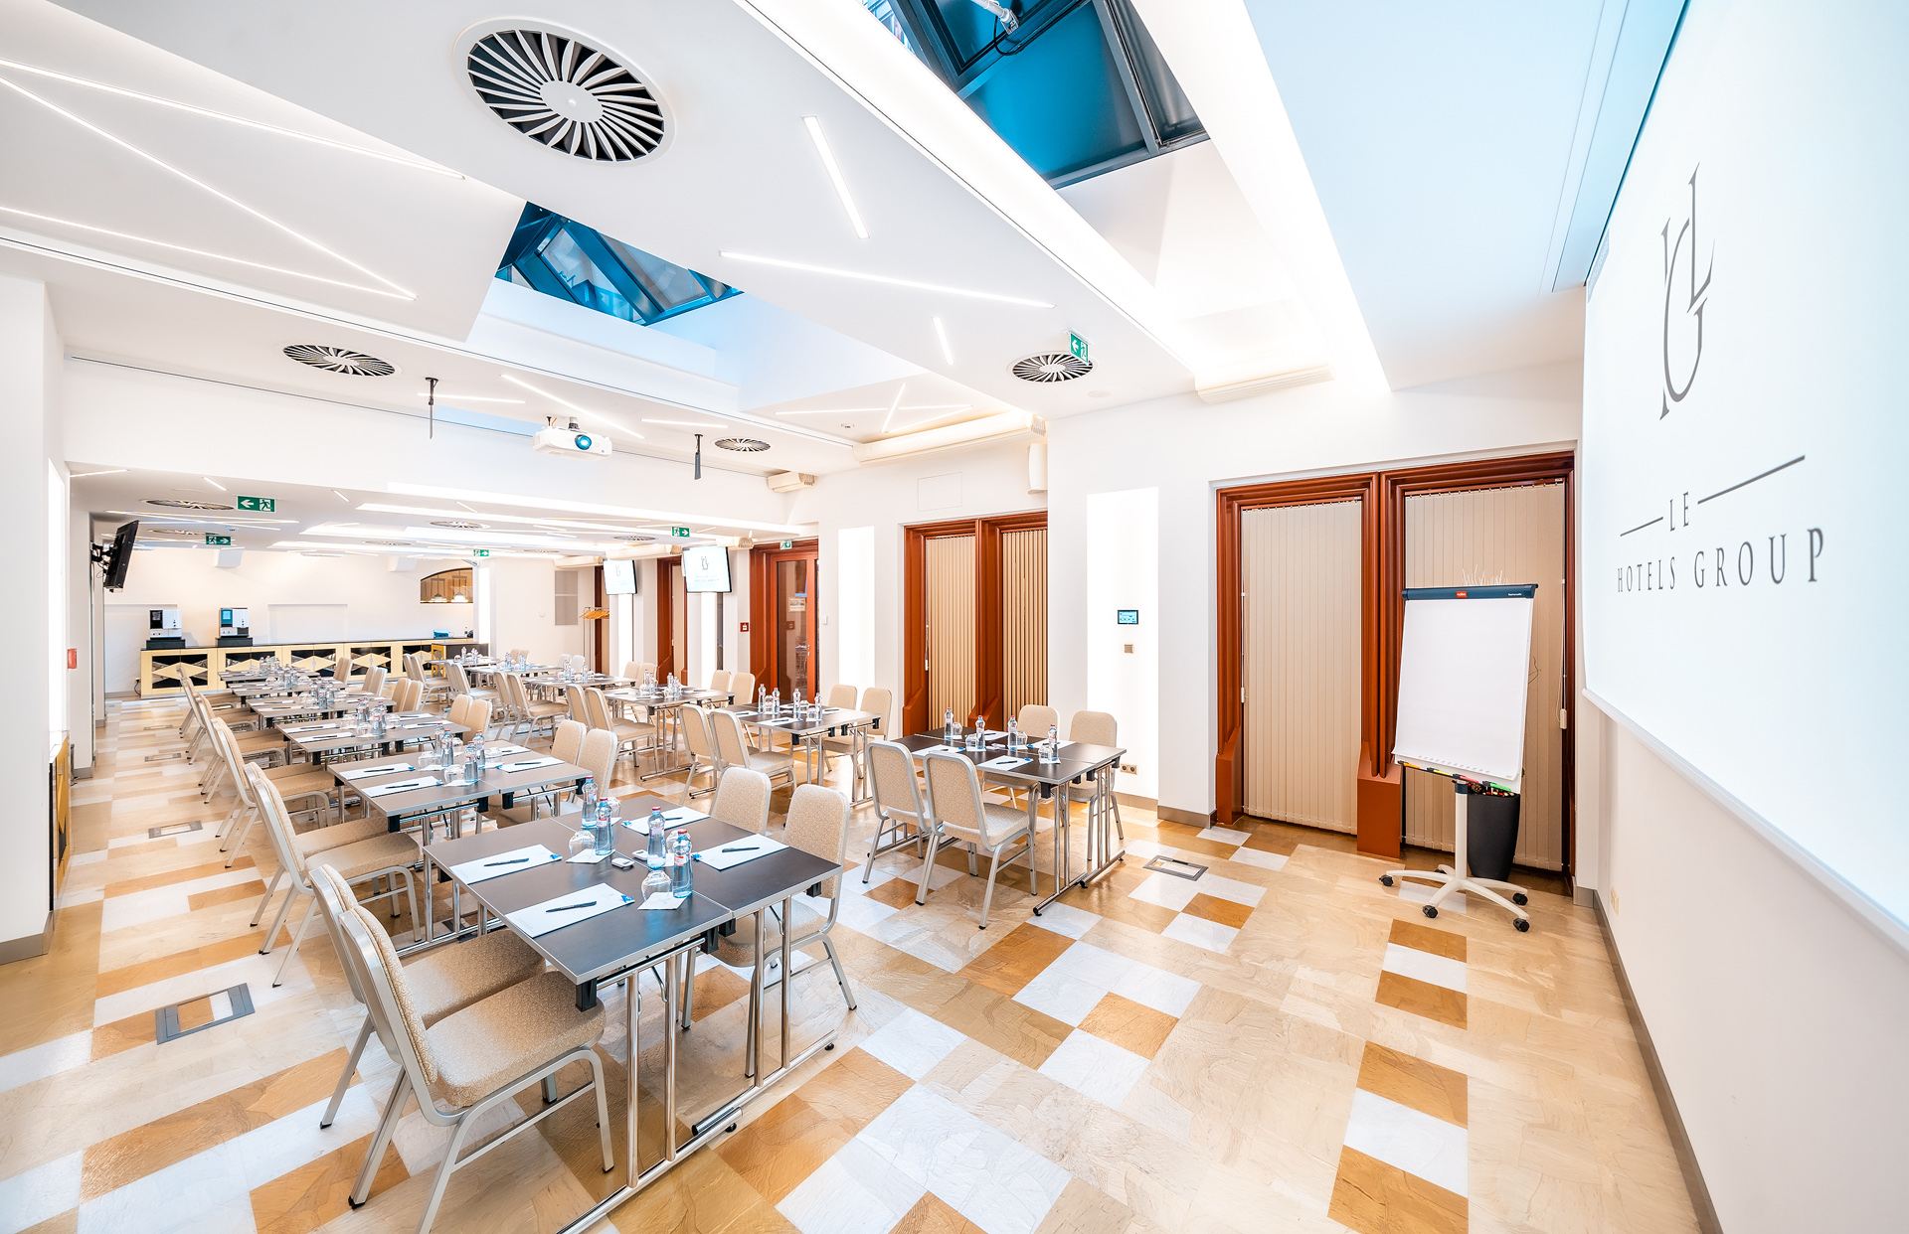
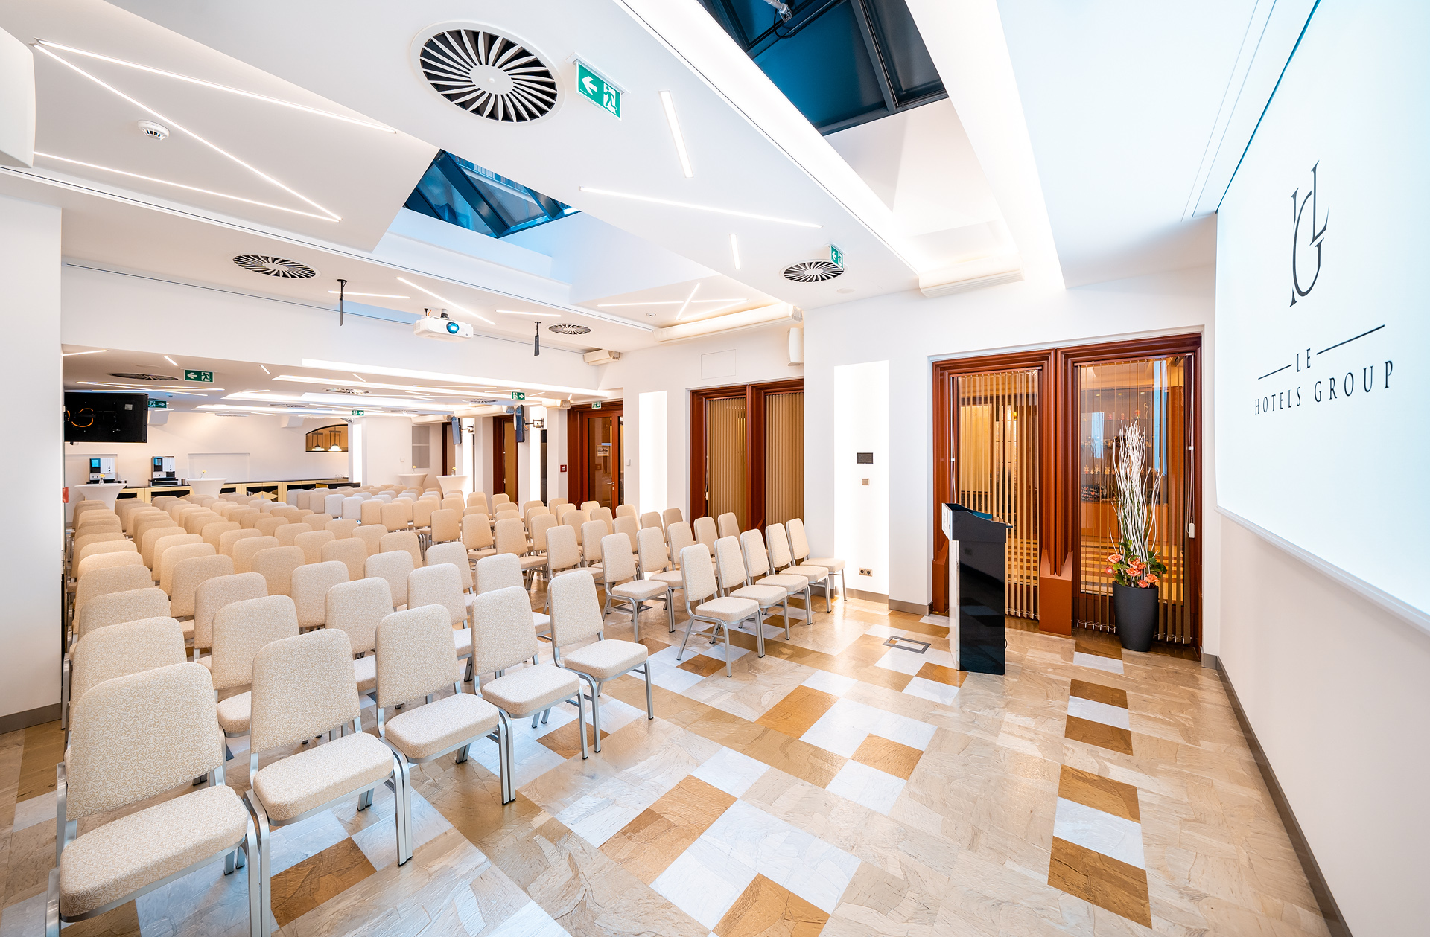
MEETING ROOM MAJESTIC IV.
Location: Ground Floor
Dimensions on metric: 133 m² (19,9 x 6,3 x 2,7 metres)
Cocktail: 115 pax
Theatre: 140 pax
Classroom 2 pax table: 78 pax
U-shape: 40 pax
Cabaret 6 pax (150 cm Table): 42 pax
Banquet 10 pax (180 cm Table): 70 pax
Block B2B: 48 pax
Exhibition table top: 18 tables

Slide 7
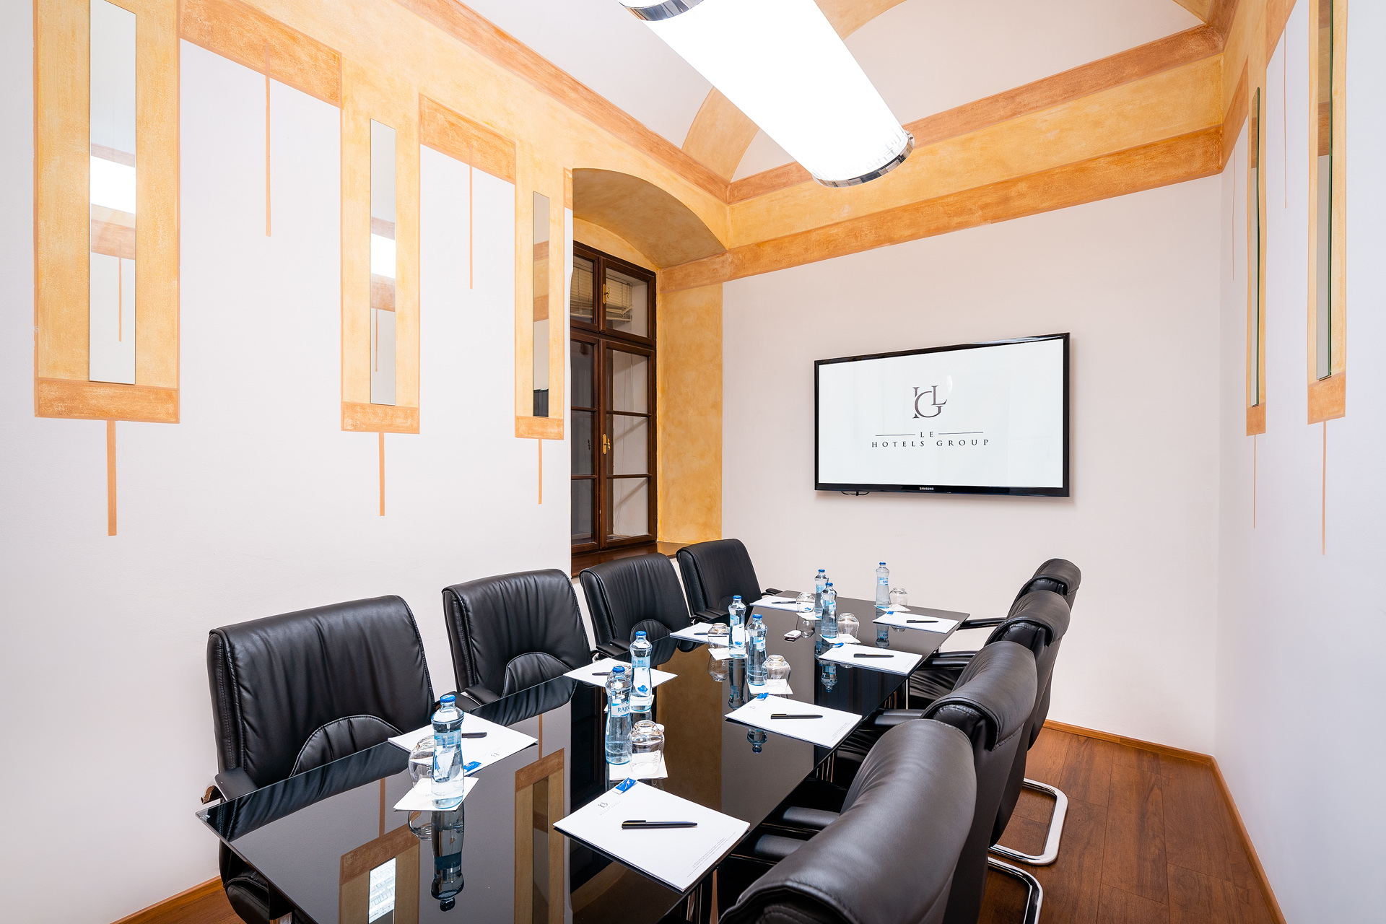
MEETING ROOM BOARD ROOM
Location: Ground Floor
Dimensions on metric: 15 m² (4,7 x 2,9 x 2,7 metres)
Cocktail: X
Theatre: 14 pax
Classroom 2 pax table: X
U-shape: 10 pax
Cabaret 6 pax (150 cm Table): X
Banquet 10 pax (180 cm Table): X
Board: 10 pax
Exhibition table top: X

